Slide 1

Chapter 3: The Enhanced E-R Model and Business Rules

Slide 2
Objectives
Definition of terms
Use of supertype/subtype relationships
Use of generalization and specialization techniques
Specification of completeness and disjointness constraints
Develop supertype/subtype hierarchies for realistic business situations
Develop entity clusters
Explain universal data model
Name categories of business rules
Notes:
Definition of terms
Use of supertype/subtype relationships
Use of generalization and specialization techniques
Specification of completeness and disjointness constraints
Develop supertype/subtype hierarchies for realistic business situations
Develop entity clusters
Explain universal data model
Name categories of business rules

Slide 3
Supertypes and Subtypes
Subtype: A subgrouping of the entities in an entity type that has attributes distinct from those in other subgroupings
Supertype: A generic entity type that has a relationship with one or more subtypes
Attribute Inheritance:
Subtype entities inherit values of all attributes of the supertype
An instance of a subtype is also an instance of the supertype
Notes:
The concept of super-type and sub-types are used to implement more complex business situations that are hierarchical in natured.
Example: Earth, Galaxy. Car and Vehicle.
Subtype: A subgrouping of the entities
Supertype: A generic entity type that has a relationship with one or more subtypes
Attribute Inheritance:
Subtype entities inherit values of all attributes of the supertype
An instance of a subtype is also an instance of the supertype

Slide 4
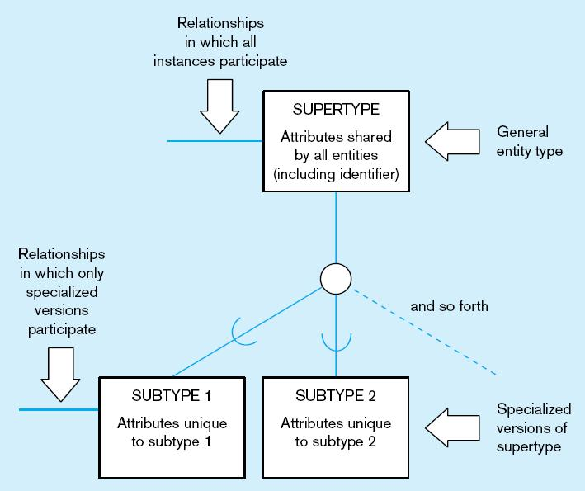
Figure 4-1 Basic notation for supertype/subtype notation
a) EER notation
Notes:
What entities can you think of that fits this model? What attributes

Slide 5
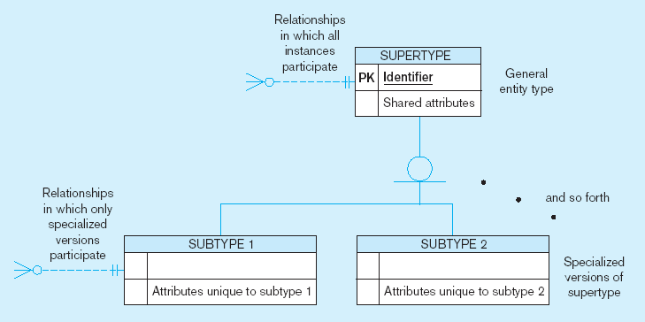
Figure 4-1 Basic notation for supertype/subtype notation (cont.)
b) Microsoft Visio Notation
Different modeling tools may have different notation for the same modeling constructs

Slide 6
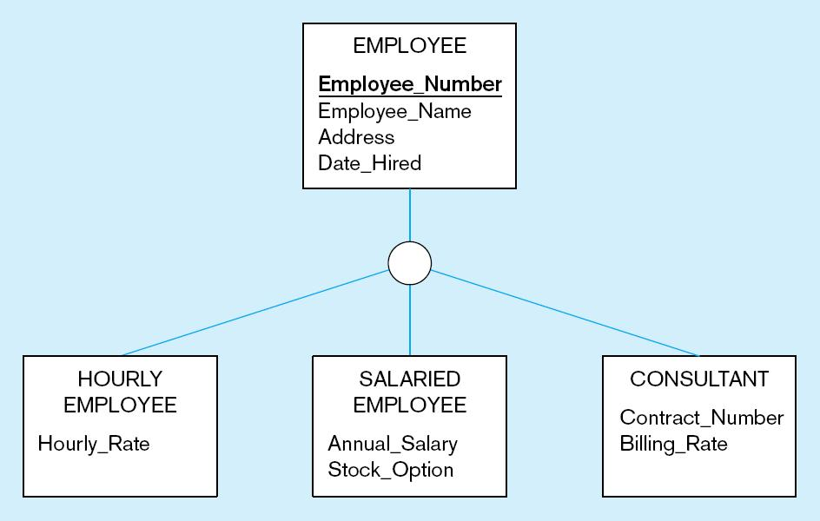
Figure 4-2 Employee supertype with three subtypes
All employee subtypes will have emp nbr, name, address, and date hired
Each employee subtype will also have its own attributes
Notes:
Shows inheritance!!!
Subtypes has its own attributes
Cannot repeat attributes

Slide 7
Relationships and Subtypes
Relationships at the supertype level indicate that all subtypes will participate in the relationship
The instances of a subtype may participate in a relationship unique to that subtype. In this situation, the relationship is shown at the subtype level
Notes:
Relationships at the supertype -> all instances participate
The instances of a subtype may or may not participate in a relationship

Slide 8
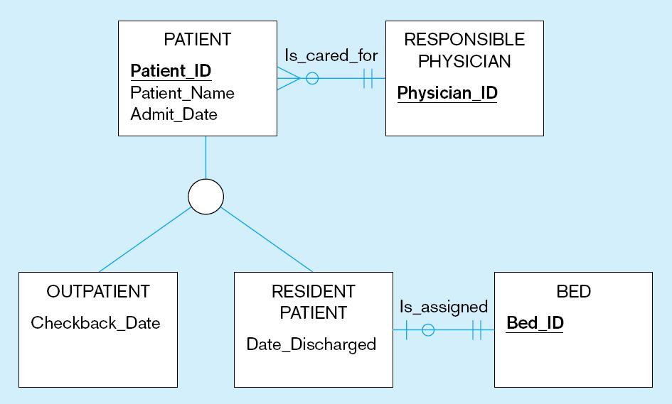
Figure 4-3 Supertype/subtype relationships in a hospital
Both outpatients and resident patients are cared for by a responsible physician
Only resident patients are assigned to a bed
Notes:
Does outpatient entity participate in the responsible physician relationship?

Slide 9
Modeling Techniques
Generalization: The process of defining a more general entity type from a set of more specialized entity types. BOTTOM-UP
Specialization: The process of defining one or more subtypes of the supertype and forming supertype/subtype relationships. TOP-DOWN
Notes:
There are data modeling techniques, and design thinking techniques to come up with EER
Generalization: The process of defining a more general entity type from a set of more specialized entity types. BOTTOM-UP! City, state, country, continent, planet, our galaxy, universe.
Specialization: The process of defining one or more subtypes of the supertype and forming supertype/subtype relationships. TOP-DOWN: city:, what about zip codes, what about street names, what about house names

Slide 10
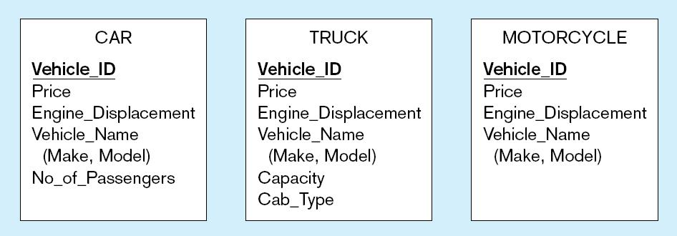
Figure 4-4 Example of generalization
a) Three entity types: CAR, TRUCK, and MOTORCYCLE
All these types of vehicles have common attributes

Slide 11
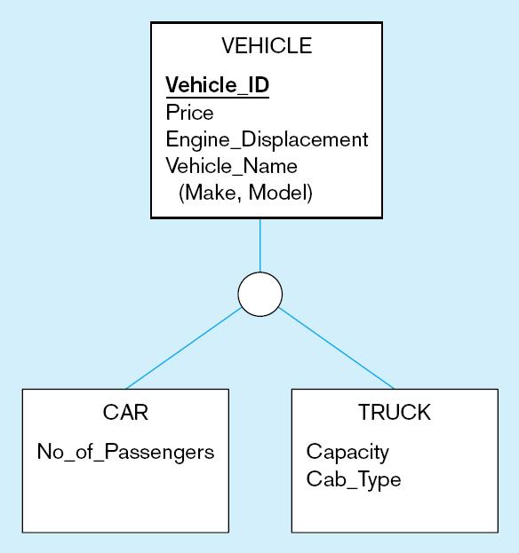
Figure 4-4 Example of generalization (cont.)
b) Generalization to VEHICLE supertype
So we put the shared attributes in a supertype
Note: no subtype for motorcycle, since it has no unique attributes

Slide 12
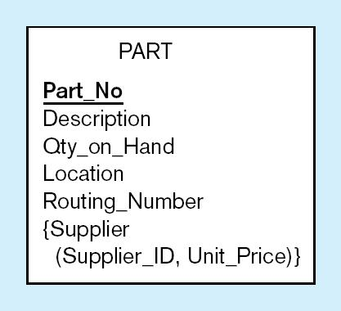
Figure 4-5 Example of specialization
a) Entity type PART
Only applies to manufactured parts
Applies only to purchased parts
Notes:
You noticed that you have attributes that apply to only certain conditions

Slide 13
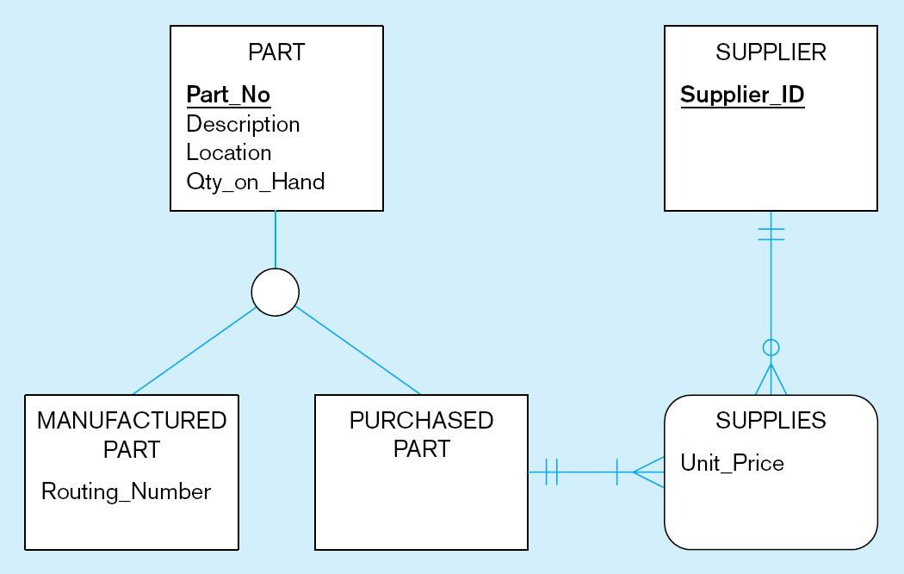
Figure 4-5 Example of specialization (cont.)
b) Specialization to MANUFACTURED PART and PURCHASED PART
Created 2 subtypes
Note: multivalued attribute was replaced by an associative entity relationship to another entity

Slide 14
Constraints in Supertype/ Completeness Constraint
Completeness Constraints: Whether an instance of a supertype must also be a member of at least one subtype
Total Specialization Rule: Yes (double line)
Partial Specialization Rule: No (single line)
Notes:
supertype must also be a member of at least one subtype

Slide 15
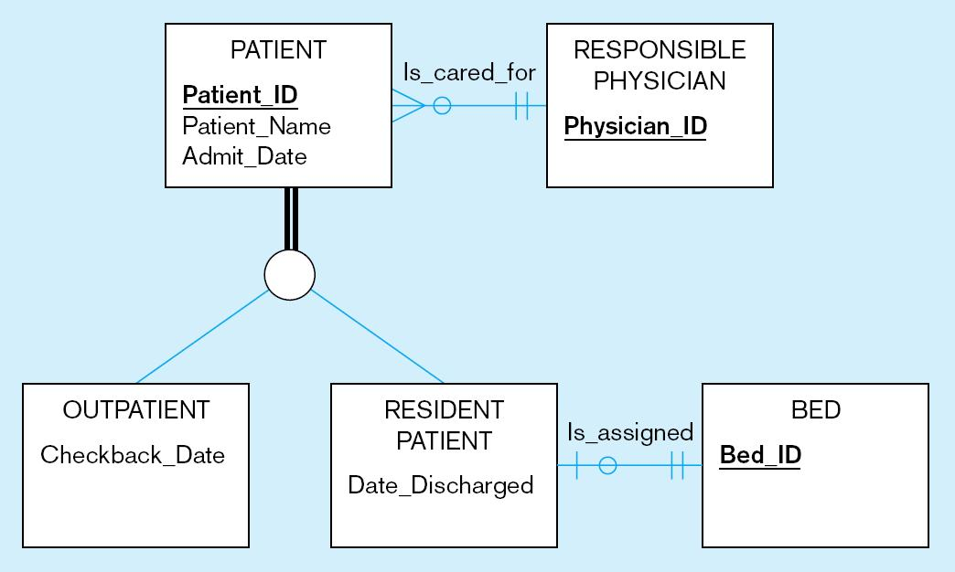
Figure 4-6 Examples of completeness constraints
a) Total specialization rule
A patient must be either an outpatient or a resident patient
Notes:
A patient must be either an outpatient or a resident.
This is Total Specialization

Slide 16
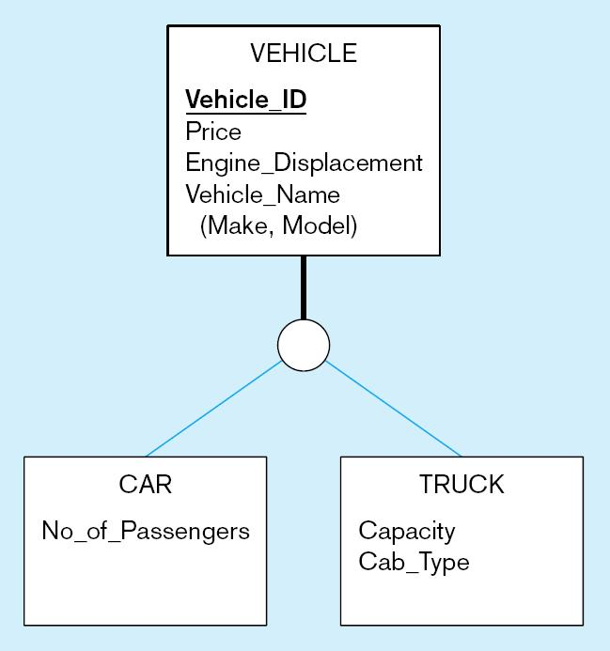
Figure 4-6 Examples of completeness constraints (cont.)
b) Partial specialization rule
A vehicle could be a car, a truck, or neither
Notes:
A vehicle, could be a car, a vehicle or neither.
Partial specialization

Slide 17
Constraints in Supertype/ Disjointness constraint
Disjointness Constraints: Whether an instance of a supertype may simultaneously be a member of two (or more) subtypes
Disjoint Rule: An instance of the supertype can be only ONE of the subtypes
Overlap Rule: An instance of the supertype could be more than one of the subtypes
Notes:
Whether an instance of a supertype may simultaneously be a member of two (or more) subtypes

Slide 18
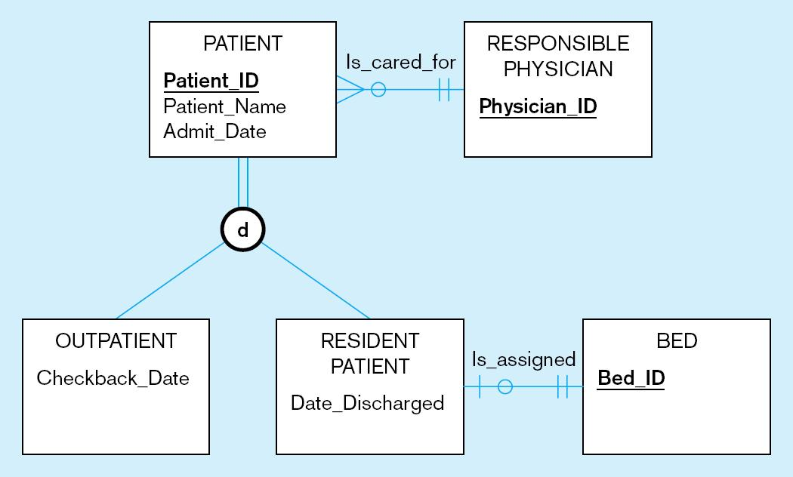
Figure 4-7 Examples of disjointness constraints
a) Disjoint rule
A patient can either be outpatient or resident, but not both
Notes:
Completeness constraint is a total specialization. It must be in one of them
Disjoints constraints says it cannot be both.

Slide 19
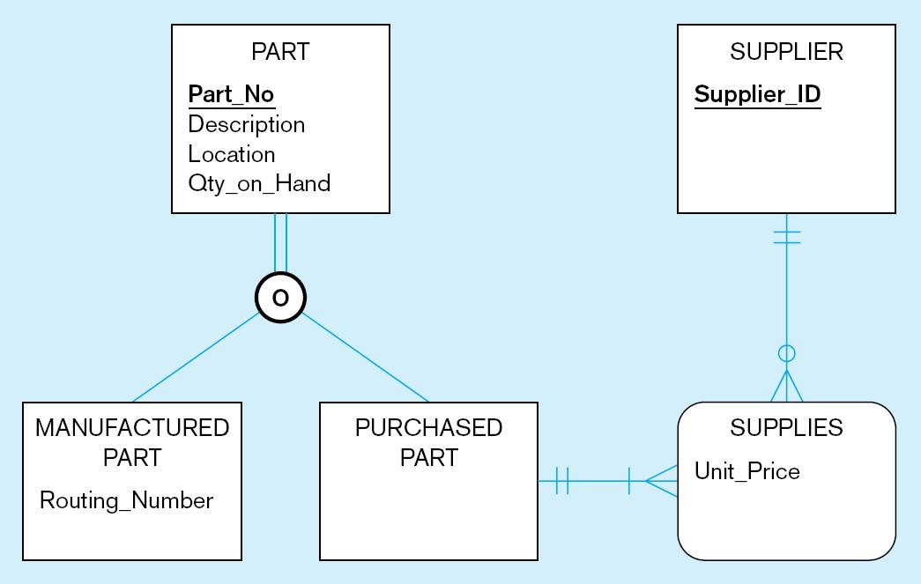
Figure 4-7 Examples of disjointness constraints (cont.)
b) Overlap rule
A part may be both purchased and manufactured
Notes:
Completeness constraint = A part may be both purchased and manufactured!
Overlap says, a part could be both manufactured and purchased

Slide 20
Constraints in Supertype/ Subtype Discriminators
Subtype Discriminator: An attribute of the supertype whose values determine the target subtype(s)
Disjoint – a simple attribute with alternative values to indicate the possible subtypes
Overlapping – a composite attribute whose subparts pertain to different subtypes. Each subpart contains a Boolean value to indicate whether or not the instance belongs to the associated subtype
Notes:
Values to determine target subtypes. It helps to make the model more efficient to reduce searches

Slide 21
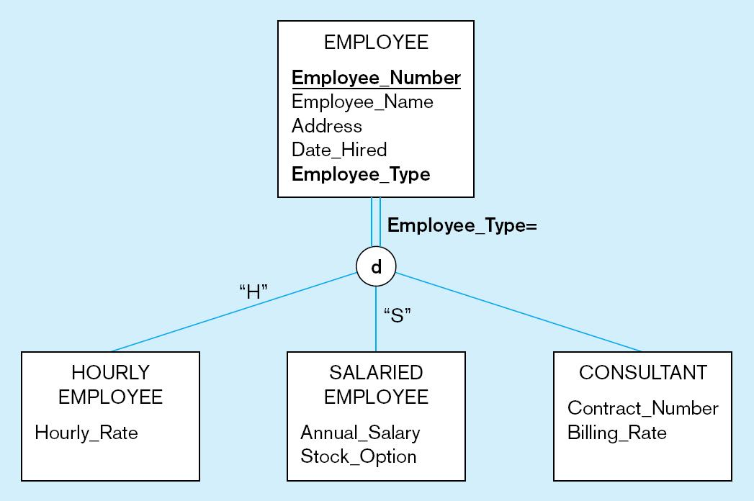
Figure 4-8 Introducing a subtype discriminator (disjoint rule)
A simple attribute with different possible values indicating the subtype
Notes:
Completeness constraint = Total specialization
Disjoint constraints says, it either one of the 3, not both
How do you know how to find a specific employee. Discriminator guides you to which entity to look for

Slide 22
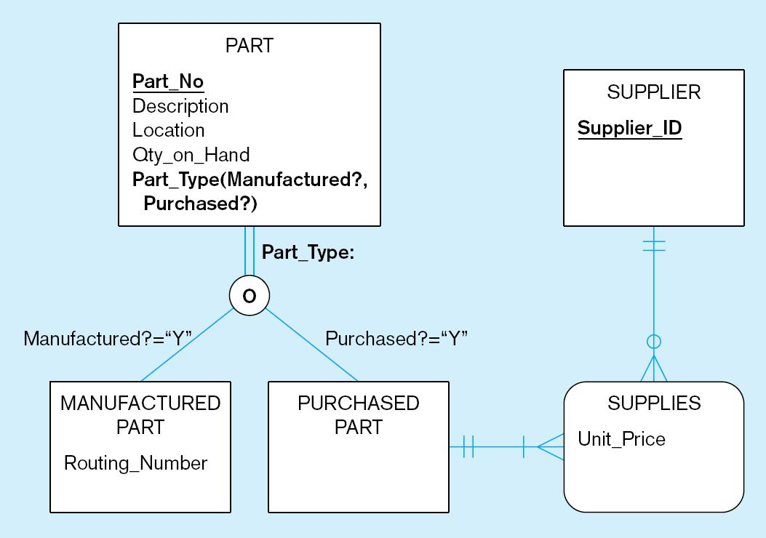
Figure 4-9 Subtype discriminator (overlap rule)
A composite attribute with sub-attributes indicating “yes” or “no” to determine whether it is of each subtype

Slide 23
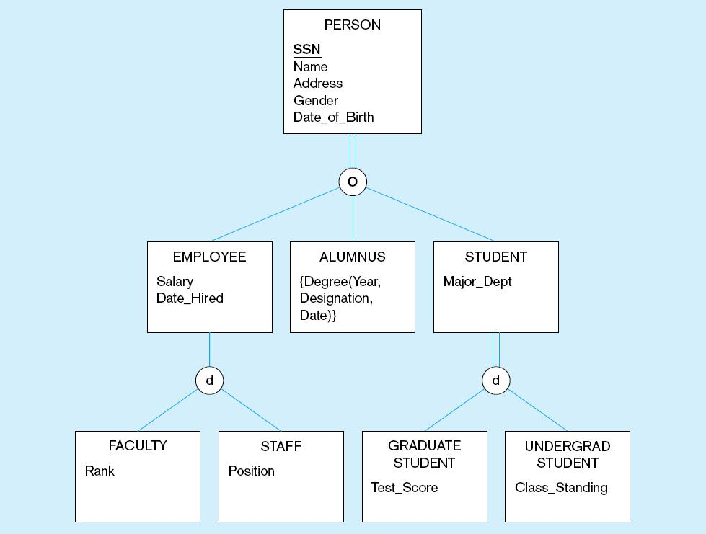
Figure 4-10 Example of supertype/subtype hierarchy
Notes:
Can a person be both an employee and a student? An alum and a student? Yes because of overlapping ruling
Can a person be neither an employer, nor alum nor a student? No, completeness rule = total specialization
Can an employee be neither a faculty or a staff? Yes, partial specialization rule. Single line
Can a student be neither a grand nor and undergrad? No, completeness= total specialization
Can a student be both a grad and undergrad? No, disjoint rule

Slide 24
Draw an EERD for the following description of a law firm:
Each case handled by the firm has a unique case number; a date opened, date closed, and judgment description are also kept on each case. A case is brought by one or more plaintiffs, and the same plaintiff may be involved in many cases. A plaintiff has a requested judgment characteristic. A case is against one or more defendants and the same defendant may be involved in many cases. A plaintiff or defendant may be a person or an organization. Over time, the same person or organization may be a defendant or a plaintiff in cases. In either situation, such legal entities are identified by an entity number, and other attributes are name and net worth.

Slide 25
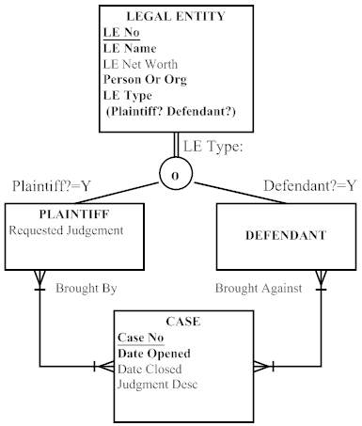
Notes:
Notes:
1) Person Or Org attribute denotes Person or Organization type of Legal Entity. There is no reason to show Person and Organization as subtypes of Legal Entity, as there are no special attributes or relationships identified in the scenario.
2) The same legal entity cannot be both a Plaintiff and Defendant in the same Case.
3) Although DEFENDANT has no other unique attributes, it is required as a subtype to show the parties involved in a CASE. Further, the DEFENDANT subtype is necessary to show the Brought Against role that is necessary to defining the parties in a CASE.

Slide 26
Entity Clusters
EER diagrams are difficult to read when there are too many entities and relationships
Solution: Group entities and relationships into entity clusters
Entity cluster: Set of one or more entity types and associated relationships grouped into a single abstract entity type

Slide 27
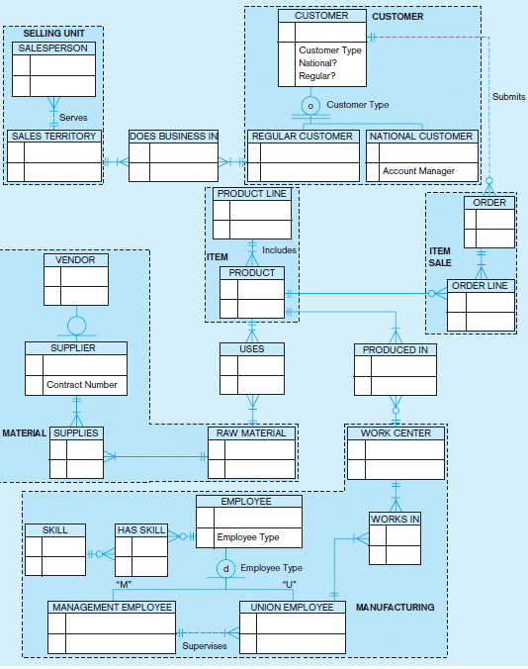
Figure 3-13a Possible entity clusters for Pine Valley Furniture in Microsoft Visio
Related groups of entities could become clusters

Slide 28
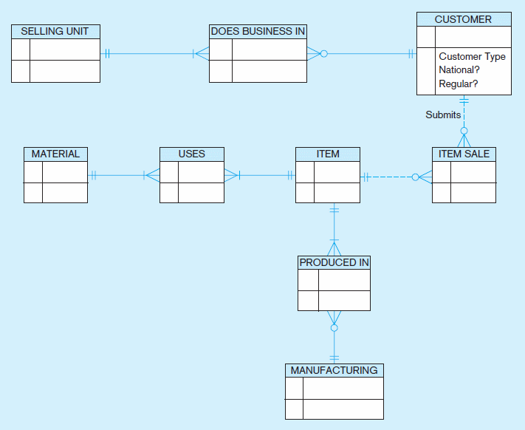
Figure 3-13b EER diagram of PVF entity clusters
More readable, isn’t it?

Slide 29
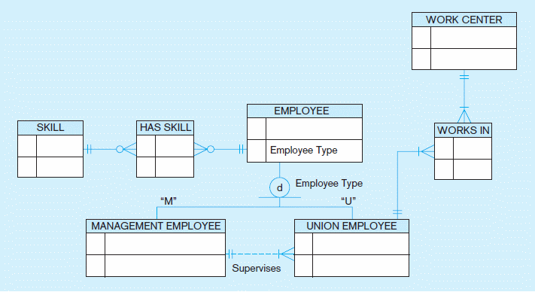
Figure 3-14 Manufacturing entity cluster
Detail for a single cluster

Slide 30
Packaged Data Models
Predefined data models
Could be universal or industry-specific
Universal data model = a generic or template data model that can be reused as a starting point for a data modeling project (also called a “pattern”)

Slide 31
Advantages of Packaged Data Models
Use proven model components
Save time and cost
Less likelihood of data model errors
Easier to evolve and modify over time
Aid in requirements determination
Easier to read
Supertype/subtype hierarchies promote reuse
Many-to-many relationships enhance model flexibility
Vendor-supplied data model fosters integration with vendor’s applications
Universal models support inter-organizational systems

Slide 32
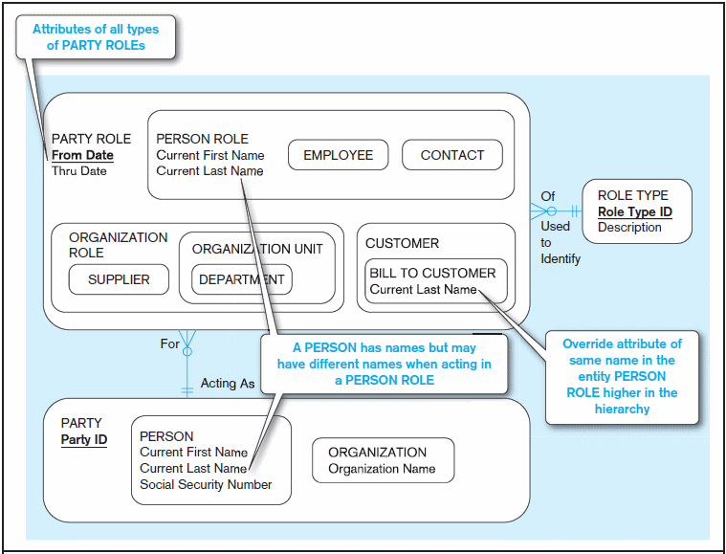
Figure 3-15 PARTY, PARTY ROLE, and ROLE TYPE in a universal data model
(a) Basic PARTY universal data model
Packaged data models are generic models that can be customized for a particular organization’s business rules

Slide 33
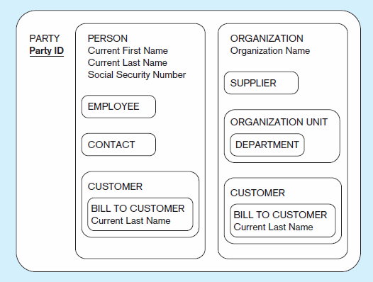
Figure 3-15 PARTY, PARTY ROLE, and ROLE TYPE in a universal data model
(b) PARTY supertype/subtype hierarchy

Slide 34
Draw an EER diagram for the following problem using this text’s EER notation AND notation from your modeling tool such as Visio
A nonprofit organization depends on several different types of persons for its successful operation. The organization is interested in the following attributes for all these persons: SSN, Name, Address, City/State/Zip, and Telephone. Three types of persons are of greatest interest: employees, volunteers, and donors. Employees have only a Date Hired attribute, and volunteers have only a Skill attribute. Donors have only a relationship (named Donates) with an Item entity type. A donor must have donated one or more items, and an item may have no donors or one or more donors. There are persons other than employees, volunteers, and donors who are of interest to the organization so that a person need not belong to any of these three groups. On the other hand, at a given time a person may belong to two or more of these groups (e.g., employee and donor)

Slide 36
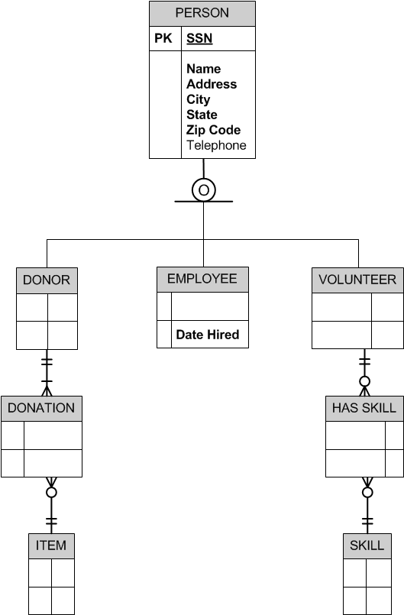
Notes:
Visio Version.

